Slide 1
■mysite5 - main
사용자
jsp
controller
service
dao
sqlSession
xml
■메인
http://localhost:8088/mysite5/
index.jsp
/
main()
요청화면
응답화면
*메인
deleteForm.jsp

Slide 2
■mysite5 - user
사용자
jsp
controller
service
dao
sqlSession
xml
■회원가입폼
http://localhost:8088/mysite5/user/joinForm
joinForm.jsp
/user/joinForm
joinForm()
요청화면
응답화면
*회원가입 폼
@ModelAttribute
UserVo{
id=aaa
password=1234
name=황일영
gender=male
}
■회원가입
UserVo
UserVo
UserVo
parameterType UserVo
http://localhost:8088/mysite5/user/join?
/user/join
join(UserVo)
join(UserVo)
요청화면
id=aaa&password=1234&name=황일영&gender=male
count
count
insert(UserVo)
*성공갯수
insert(“user.insert”, UserVo)
id=user.insert
joinOk.jsp
응답화면
*회원가입성공
@ModelAttribute
UserVo{
id=aaa
password=1234
}
UserVo{
id=aaa
password=1234
}
UserVo{
id=aaa
password=1234
}
UserVo{
id=aaa
password=1234
}
■로그인
UserVo
UserVo
UserVo
parameterType UserVo→id password
http://localhost:8088/mysite5/user/login?
/user/login
login(UserVo)
요청화면
id=aaa&password=1234
UserVo
login(UserVo)
UserVo
selectUser(UserVo)
UserVo
selectOne(“user.selectUser”, UserVo)
id=user.selectUser
redirect: / → main
로그인 성공이면
UserVo{
no=24
name=“황일영”
}
UserVo{
no=24
name=“황일영”
}
resultType UserVo→no name
응답화면
UserVo→authUser
→세션저장→최소정보(no, 이름)
redirect: / → main
로그인 실패이면
http://localhost:8088/mysite5/
redirect: / → user/loginForm?result=fail
응답화면
redirect: /user/loginForm?result=fail
http://localhost:8088/mysite5/user/loginForm?result=fail
■로그아웃
http://localhost:8088/mysite5/user/logout
/user/logout
logout()
요청화면
redirect: / → main
세션 authUser삭제
응답화면
redirect: / → main
http://localhost:8088/mysite5/
deleteForm.jsp

Slide 3
■mysite5 - user
사용자
jsp
controller
service
dao
sqlSession
xml
■회원정보 수정폼
no=24
no=24
no=24
parameterType int
http://localhost:8088/mysite5/user/modifyForm
/user/modifyForm
modifyForm(){
}
modifyForm(no)
selectUser(no)
selectOne(“user.selectUserByNo”, no)
id=user.selectUserByNo
요청화면
modifyForm.jsp
UserVo
no=24 ←session
UserVo
UserVo
resultType UserVo
응답화면
*회원정보 수정 폼
@ModelAttribute
UserVo{
no =
id=
password=1234
name=황일영
gender=male
}
UserVo{
no = 24 <-- session
id=
password=1234
name=황일영
gender=male
}
UserVo{
no = 24 <-- session
id=
password=1234
name=황일영
gender=male
}
■회원정보 수정
parameterType UserVo
http://localhost:8088/mysite5/user/modify?
/user/modify
modify(){
}
요청화면
password=1234&name=황일영&gender=male
modify(UserVo)
count
update(UserVo)
*성공갯수
update(“user.update”, UserVo)
id=user.update
no=24 ←session
redirect: / → main
세션에 이름변경
redirect: / → main
count
응답화면
redirect: / → main
http://localhost:8088/mysite5/
deleteForm.jsp

Slide 4
■mysite5 - guestbook
사용자
jsp
controller
service
dao
sqlSession
xml
■방명록 리스트
/guestbook/addList
addList(Model model)
addList()
getGuestList()
selectList(“guestbook.selectList”)
id=guestbook.selectList
http://localhost:8088/mysite5/guestbook/addList
addList.jsp
resultType com.javaex.vo.GuestbookVo
요청화면
Model.addAttribute(“gList”,guestbookList)
List<GuestbookVo>
List<GuestbookVo>
List<GuestbookVo>
응답화면
*방명록 리스트
@ModelAttribute
GuesbookVo{
name=최태현
password=1234
content=테스트}
■방명록 등록
/guestbook/add
add(@ModelAttribute GuestbookVo guestbookVo)
add(GuestbookVo guestbookVo)
id=guestbook.insert
http://localhost:8088/mysite5/guestbook/add?name=최태현&password=1234&content=테스트
guestInsert(GuestbookVo guestbookVo)
insert(“guestbook.insert”, guestbookVo)
parameterType com.javaex.vo.GuestbookVo
요청화면
응답화면
*redirect:/guestbook/addList
리다이렉트
http://localhost:8088/mysite5/guestbook/addList
■방명록 삭제 폼
http://localhost:8088/mysite5/guestbook/deleteForm?no=2
deleteForm.jsp
/guestbook/deleteForm
deleteForm()
요청화면
응답화면
*방명록 삭제 폼
@ModelAttribute
GuesbookVo{
no=2
password=1234}
■방명록 삭제
/guestbook/delete
delete(@ModelAttribute GuestbookVo guestbookVo)
List<GuestbookVo>
http://localhost:8088/mysite5/guestbook/delete?no=2&password=1234
delete(GuestbookVo guestbookVo)
guestDelete(GuestbookVo guestbookVo)
delete(“guestbook.delete”, guestbookVo)
id=guestbook.delete
요청화면
count
count
parameterType com.javaex.vo.GuestbookVo
응답화면
*방명록 리스트
if count == 1 (삭제성공)
redirect:/guestbook/addList
else (삭제실패)
응답화면
*방명록 삭제 폼
redirect:/guestbook/deleteForm?count=0&no=guestbookVo.getNo()

Slide 5
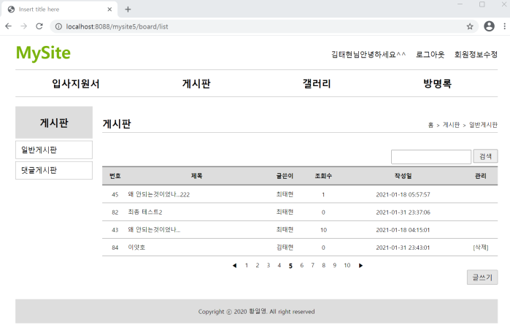
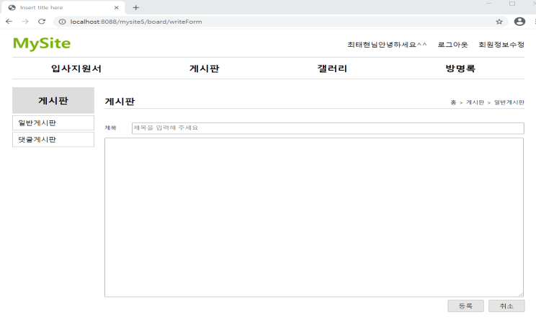
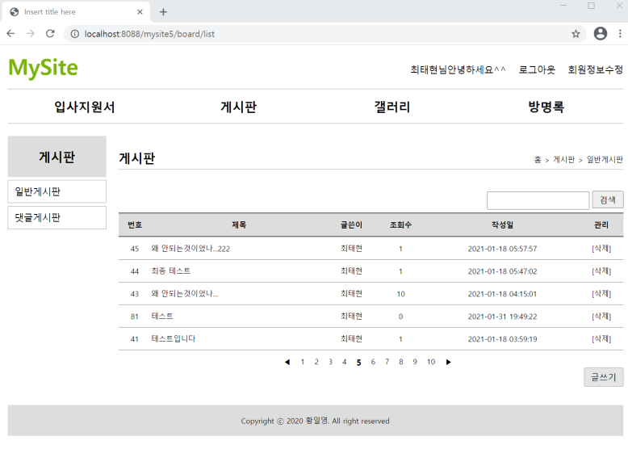
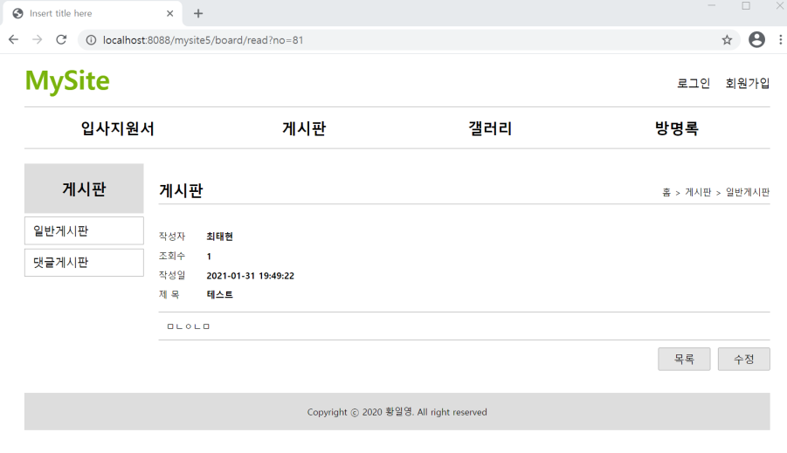
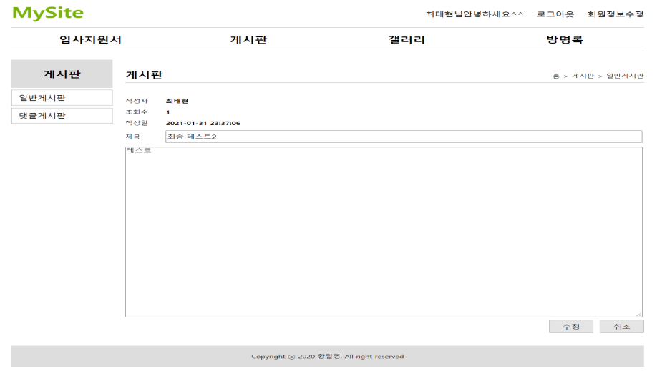

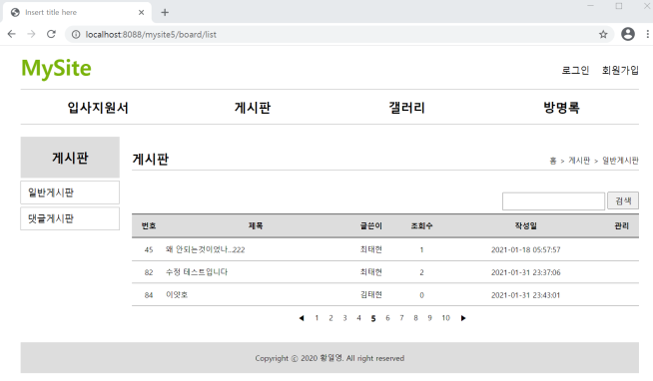
■mysite5 - board
사용자
jsp
controller
service
dao
sqlSession
xml
■게시판 리스트
/board/list
list(Model model)
list()
getBoardList()
selectList(“board.selectList”)
id=board.selectList
http://localhost:8088/mysite5/board/list
resultType com.javaex.vo.BoardVo
요청화면
포워드 list.jsp
Model.addAttribute(“bList”,boardList)
List<BoardVo>
List<BoardVo>
List<BoardVo>
■게시판 글쓰기 폼
http://localhost:8088/mysite5/board/writeForm
/board/writeForm
writeForm()
요청화면
포워드 writeForm.jsp
■게시판 글쓰기
@ModelAttribute
BoardVo{
title=테스트
content=내용테스트}
http://localhost:8088/mysite5/board/write?title=테스트&content=내용테스트
/board/write
write(@ModelAttribute BoardVo)
BoardVo
write(BoardVo boardVo)
BoardVo
boardInsert(BoardVo boardVo)
BoardVo
insert(“board.insert”, boardVo)
id=board.insert
요청화면
세션 – authUse
parameterType com.javaex.vo.BoardVo
"redirect:/board/list";
세션 – authUser에서 no가져오기
가져온 UserNo 값 BoardVo에 넣어주기
@ModelAttribute
BoardVo{
title=테스트
content=내용테스트
userNo=81}
■게시글 보기
no
no
no
http://localhost:8088/mysite5/board/read?no=81
/board/read
read(int no,Model)
read(no)
updateHit(int no)
update(“board.updateHit”, no)
요청화면
BoardVo
포워드 read.jsp
Model.addAttribute(“boardRead”,boardRead)
no
selectOneRead(int no)
no
selectOne(“board.selectOneRead”, no)
id=board.updateHit
BoardVo
BoardVo
parameterType int
no
resultType com.javaex.vo.BoardVo
■게시글 수정 폼
/board/modifyForm
modifyForm(int no,Model)
no
BoardVo
http://localhost:8088/mysite5/board/modifyForm?no=81
BoardVo
modifyForm(no)
요청화면
포워드 modifyForm.jsp
Model.addAttribute(“boardRead”,boardRead)
■게시글 수정
/board/modify
modify(@ModelAttribute BoardVo)
BoardVo
BoardVo
BoardVo
http://localhost:8088/mysite5/board/modify?no=81&title=수정&content=수정내용
modify(BoardVo)
boardUpdate(BoardVo)
update(“board.update”, boardVo)
요청화면
"redirect:/board/list";
■게시글 삭제
/board/delete
erase(@RequestParam(“no”)
no
no
no
id=board.delete
http://localhost:8088/mysite5/board/delete?no=81
erase(no)
boardDelete(BoardVo)
delete(“board.delete”, no)
parameterType int
요청화면
"redirect:/board/list";

